Slide 1


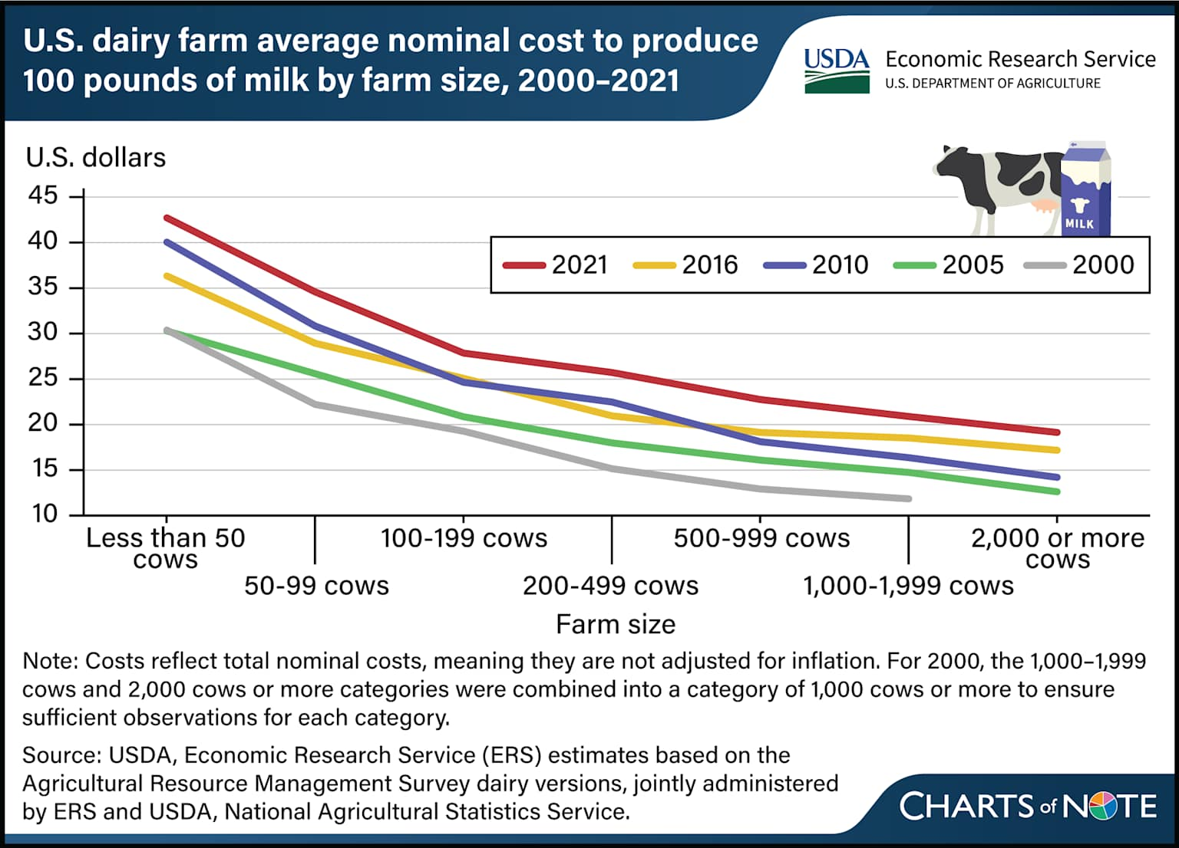
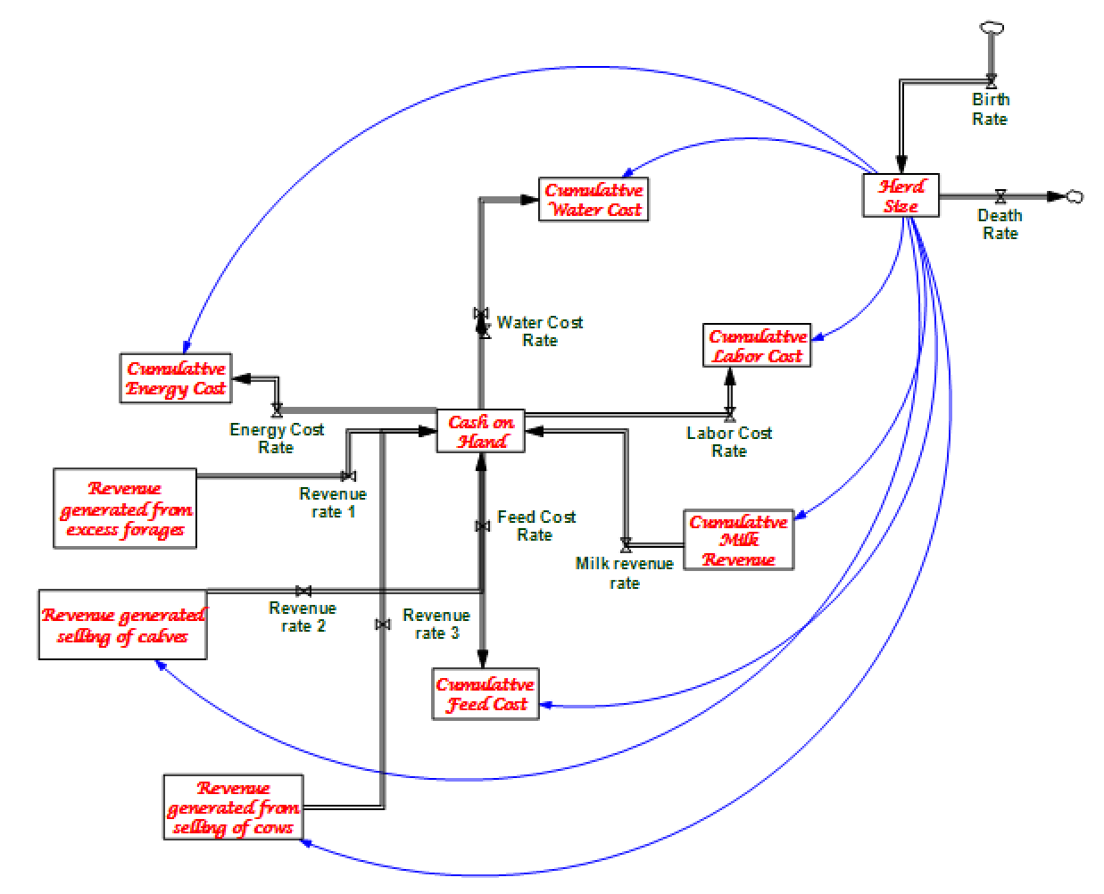
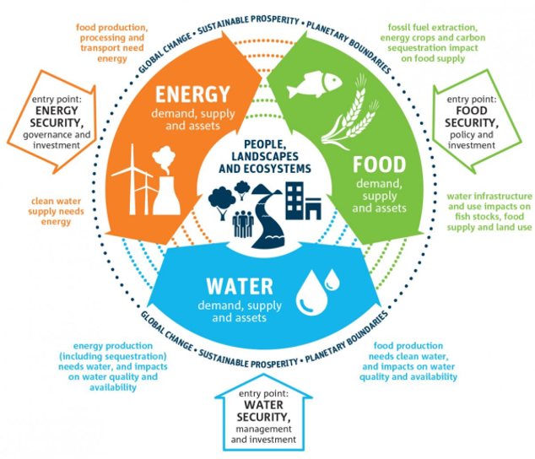
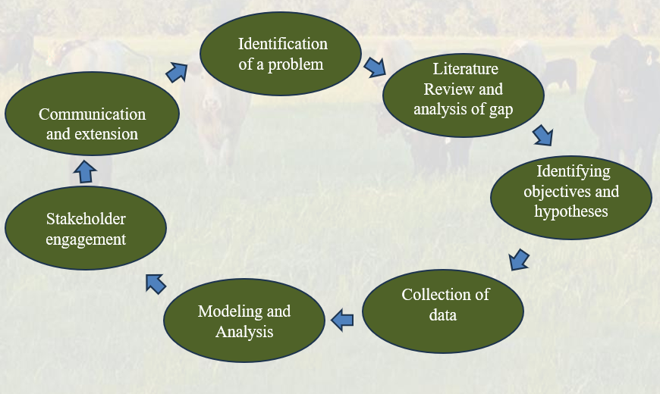

A WEF Nexus-Based Economic Assessment of Resource Efficiency in Dairy Production Systems: Team Economics
Neil Khera¹, Aarav Pulsani¹, Aparna Pushkaran Ajitha², Karun Kaniyamattan², Sushil Paudyal ²
College of Engineering¹, Department of Animal Science²
SUMMARY: This study develops a Vensim PLE system dynamics model of small and mid-size Texas dairy farms, simulating Farm Financial Capital, Installed Efficiency Capital, Herd Size, and Debt Level within a WEF nexus framework. Key variables include input costs per hundredweight, cash flow, and reinvestment rate. Baseline simulations reveal reinforcing feedback loops where lower resource costs improve margins and enable further efficiency investment. Integrated WEF management reduces input costs by 8-15%, improving long-run financial resilience. Future work will incorporate AI-driven analytics and expanded farm-level data to refine recommendations.
Dynamic hypothesis: Adoption of integrated WEF‑based resource strategies in Texas dairy production, such as improving water‑use efficiency, investing in more energy‑efficient milking and cooling systems, and aligning family and hired labor use with herd size, will strengthen positive economic feedbacks between lower input costs per hundredweight, stronger cash flow, and the capacity to reinvest in further cost‑saving technologies and management practices, leading to improved profitability and greater long‑run financial resilience of small and mid‑size dairy farms.
INTRODUCTION RESULT: STOCK & FLOW Diagram
Rising input costs and environmental pressures demand more efficient resource use in dairy production (WEF Nexus Framework)
Feed costs comprise the largest share of production expenses, followed by energy and water
Integrated WEF management strategies estimated to reduce input costs by 8–15%
Energy price volatility has the greatest marginal impact on farm profitability
Enterprise and partial budgeting frameworks applied to assess cost structures across varying herd sizes
MATERIALS AND METHODS
REFERENCES
Rising feed, energy, and water input costs demand more efficient WEF resource management in dairy production (Entrena-Barbero et al., 2023)
Feed costs comprise the largest share of production expenses, as Dry Matter Intake (DMI) drives Net Energy for Lactation (NEL) and ultimately milk output (USDA, 2025)
Integrated WEF management strategies estimated to reduce input costs by 8–15%, with energy price volatility having the greatest marginal impact on profitability (Khera & Pulsani, 2025)

